Slide 1
An Introduction to Ecology and the biosphere
52.1
By Kristen Brooks

Slide 2
Earth’s climate varies by latitude and season and is changing rapidly
The biggest influence on the distribution of organisms on land and in the oceans is climate.
There are four different physical factors that are important to each climate and those are…
Temperature
Precipitation
Sunlight
Wind
Two kinds of climate patterns are macroclimates and microclimates.
Macroclimates; global, regional and landscape level patterns ex. Sullivan County.
Microclimates; localized patterns felt in only specific places ex. Organisms under a log.

Slide 3
Global Climate Patterns
Global climate patterns are largely determined by the amount of solar energy present and earth’s movement in space.
The sun is responsible for warming the land, atmosphere and water therefore, it establishes things such as temperature variation, air and water cycles, and evaporation of water.
Regional and Local Effects on Climate
Climate patterns can be modified by numerous factors…
Seasonal variation in climate
Large bodies of water
Mountain ranges

Slide 4
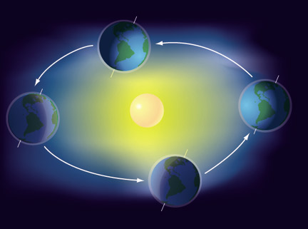
Seasonal Variations in Climate
The changing angle of the sun over the course of the year affects local environments.
Ex. Belts of wet and dry air on either side of the equator move slightly northward and southward with the changing angle of the sun producing wet and dry seasons around 20 degrees North and 20 degrees south latitude, where many rainforests are found.
Also, seasonal changes in wind patterns alter ocean currents which can cause the upwelling of cold water from deep ocean layers. This water then simulates the growth of phytoplankton and the organisms that feed on them.

Slide 5
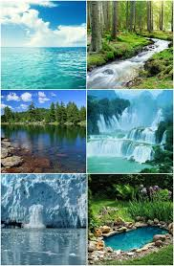
Bodies of Water
Ocean currents influence climate along the coastlines of continents by heating or cooling overlying air masses that pass across the land.
Ex. The west coast of northern Europe has a mild climate because the gulf stream carries warm water from the equator to the north Atlantic.
Due to the high specific heat of water, oceans and large lakes tend to moderate the climate of nearby land.
Also in contrast, because temperature over land drop more overnight, air over warmer air rises, drawing cooler air from the land back out over the water and replacing it with warmer air from offshore

Slide 6
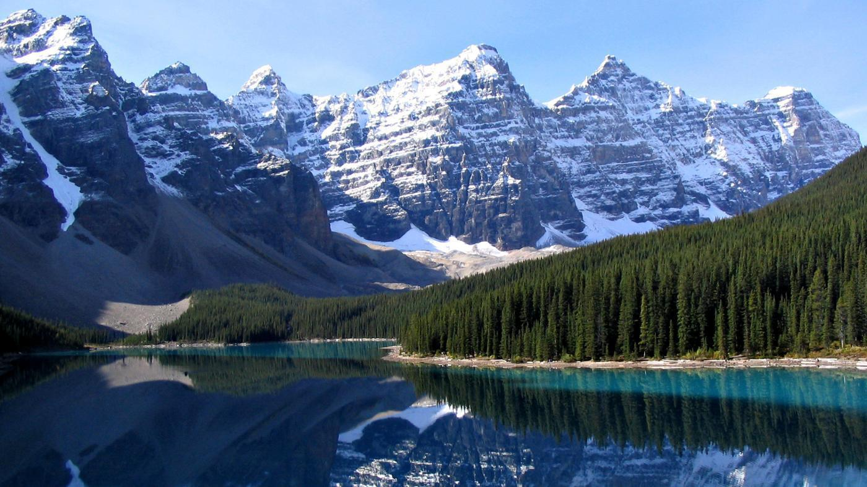
Mountain Ranges
Like bodies of water, mountain ranges influence air flow over land.
When warm air approaches a mountain, the air rises and cools, realing moisture on the windward side of the peak.
On the leeward side, cooler, dry air, descends, absorbing moisture and producing a “rain shadow”.
This rain shadow determines where many deserts are found.
Mountains also affect the amount of sunlight reaching an area thus the local temperature and rainfall.
This means south facing slopes in the northern hemisphere receives more sunlight than north facing slopes, which are therefore warmer and drier.
These influences impact species distribution locally.

Slide 7
Microclimate
Many factors in the environment influence microclimates.
Casting shade
Altering evaporation from soil
Changing wind patterns
An example would be trees covering the ground leave little room for temperature change, while areas with no tree coverage leave for greater differences in temperature throughout the day.
Another example, in the forest, low lying ground is usually wetter than higher ground and tends to be occupied by different tree species.
Every environment in earth is characterized by a mosaic of small scale differences making them Abiotic and Biotic.

Slide 8
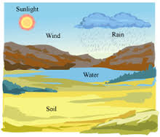
Abiotic
Abiotic factors are nonliving, these can be chemical or physical contributes.
Light
Rocks
Water
Temperature
Sand
These factors influence the distribution and abundance of organisms.

Slide 9
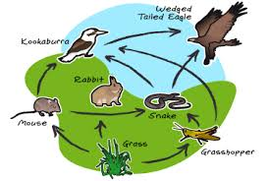
Biotic
Abiotic factors are living things such as…
Plants
Humans
Animals
These are the other organisms that are part of an individual's environment, which also influence the distribution and abundance of organisms.

Slide 10
Global Climate Change...

Slide 11
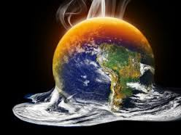
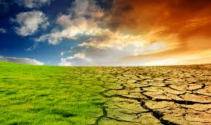
Global Climate Change
Any large scale change Earth’s climate can alter the biosphere.
Currently, the burning of fossil fuels and deforestation are increasing the concentrations of carbon dioxide and other greenhouse gassesin the atmosphere.
As a result, the the Earth has warmed 0.8 celsius since 1900, and is predicted to warm another 1-6 degrees more by 2100.
A way to determine how Earth will change is for researchers to determine the climatic limits of current distributions of organisms.

Slide 12
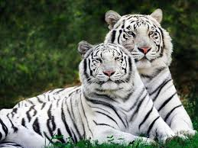
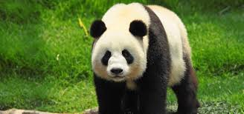
Will species be able to keep up?
Ecologists have attempted to answer this question specifically for the American Beech.
They predict that the northern limit of the beech’s range may move 700-900 km northward in the next century, and its southern range will limit shift even more.
Changes in the distribution of species are already evident in many well known groups of organisms due to the warmer world.
The observation of these climate changes causing species to move illustrates the importance of climate in determining species distributions.

Slide 13
Bottom line- climate change must be monitored to ensure the safety and well being of species on earth.

Slide 14
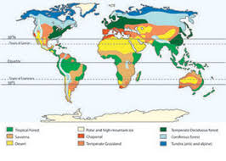
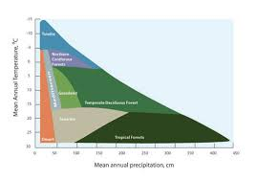
52.2 - Structure and distribution of terrestrial biomes are controlled by climate and disturbance

Slide 15
What are biomes?
Major life zones characterized by vegetation type (in terrestrial biomes) or by the physical environment (in aquatic biomes).

Slide 16
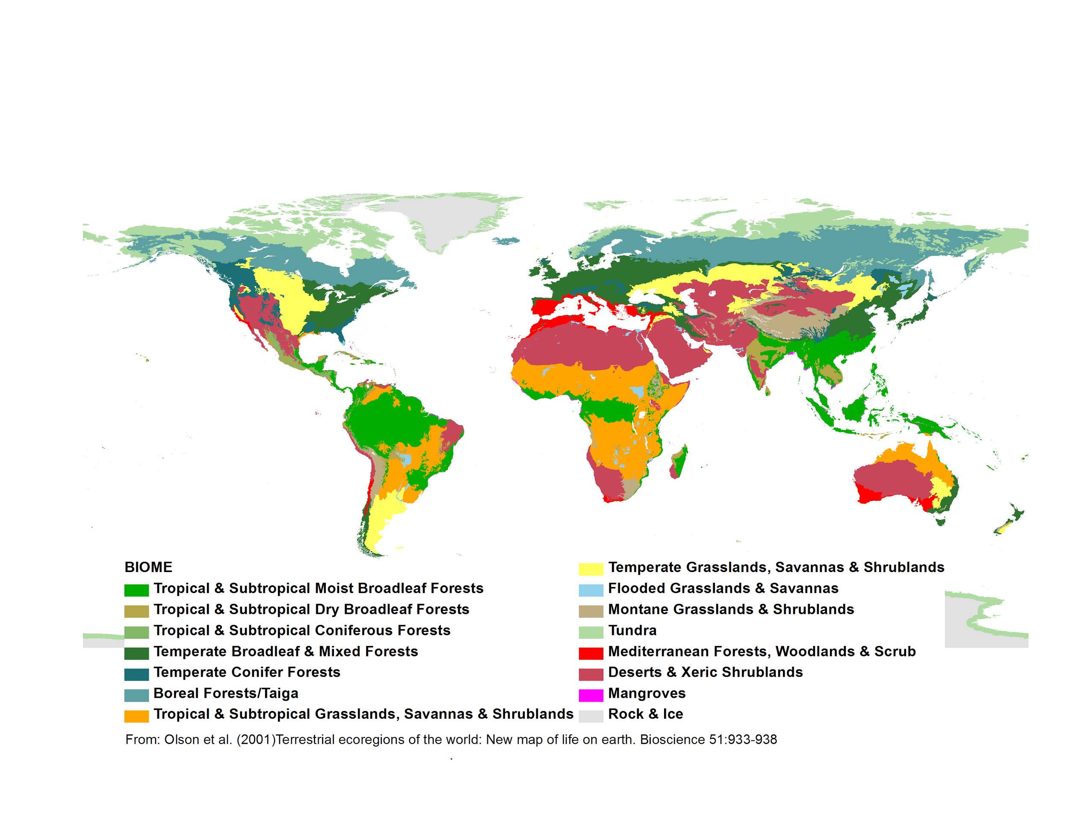
Climate and terrestrial biomes
To highlight the importance of climates on the distribution of biomes is to construct a climograph, a plot of annual mean temperature and precipitation in a particular region. These plots help show the location of biomes.

Slide 17
General features of terrestrial biomes
Most terrestrial biomes are named after their major physical or climatic features and for their predominant vegetation.
An example would be how temperate grasslands are generally found in middle latitudes, where the climate is more moderate than in the polar regions, and are dominated by various grass species.
Each biome is categorized by microorganisms such as fungi or animals adapted to that environment.

Slide 18
General biomes continued...
Biomes often show distinct boundaries between each other. Terrestrial biomes usually grade into each other without sharp edges.
The area of intergradation is called the ecotone, which can be wide or narrow.
Biomes can have layers, top to bottom, which consist of…
Upper canopy
Low-tree layer
Shrub understory
Ground layer
Forest floor
Root layer

Slide 19
General biomes continued...
Species composition of each kind of biome from location to location.
An example of this would be in North America, red spruce is common is common in the east but does not occur in other areas, where black and white spruce are very common.
Disturbance and Terrestrial Biomes
Disturbance is an event such as a storm, fire, or human activity that changes a community removing organisms from it and altering resource availability.
As a result of disturbances, biomes often exhibit extensive patchiness, with several different communities represented in a single area.

Slide 20
When discussing biomes, it is important to remember that human activity has altered so much of Earth’s surface, replacing natural communities with urban and agricultural ones.
Some natural disturbances are needed to help control biomes. However, human based ones not so much.

